Slide 1



Machine Learning
Lecture 03: Types of Attributes
Instructor: Dr. Shazia Saqib

Slide 2

Content
Understanding different types of attributes in data
Analyzing data distribution
Detecting outliers
Measuring similarity between data objects

Slide 3



What is an Attribute?
Database term:
Machine Learning term:
Statistical term:
Attribute - A column in a database table representing a specific property
Feature - An independent variable used for prediction or classification
Variable - A measurable property that can take different values
Definition: An attribute is a distinct characteristic or property of a data object that can be measured, quantified, or categorized.

Slide 4

What is a Data Object?
Definition: A data object is a fundamental entity that represents a single record, instance, or entry in a dataset, characterized by its attributes.
Example: In a customer database, each row represents one data object—a unique customer—with attributes such as age, gender, purchase history, and geographic location.
Synonyms for Data Object:
When plotting data, each point on a scatter plot represents a single data object, positioned according to its attribute values.
Sample (in statistics)
Observation (in research)
Data Point (in visualization)

Slide 5
Types of Attributes
Four major types of attributes:
1
Nominal Attributes
2
Binary Attributes
3
Ordinal Attributes
4
Numeric Attributes

Slide 6

1. Nominal Attributes
Definition:
Characteristics:
Nominal attributes are categorical data that serve as labels or names without any quantitative value or natural ordering.
Represent distinct categories or classifications
Have no inherent order or ranking between values
Allow equality comparisons only (=, ≠)
Example:
Hair colors (Black, Brown, Blonde, Red, White), blood types (A, B, AB, O), or country names - where no category is inherently "greater than" another.

Slide 7

Nominal Attributes - Key Considerations
Numerical representation is possible
Critical limitations
These numbers serve only as placeholder codes, not quantitative values
We can assign numbers to categories (e.g., Black → 0, Brown → 1, White → 2) for computational efficiency and storage benefits.
Mathematical operations (addition, averaging, etc.) produce meaningless results
Appropriate analysis
For nominal attributes, the mode (most frequently occurring value) is the only meaningful central tendency measure.

Slide 8




2. Binary Attributes
Definition:
Example 1:
A special type of nominal attribute with only two possible values.
Smoker (Yes/No) → (1/0)
Example 2:
COVID Test (Positive/Negative) → (1/0)

Slide 9

Symmetric vs. Asymmetric Binary Attributes
Symmetric Binary Attributes:
Asymmetric Binary Attributes:
Both values are equally important
One value is more important
Example: Gender (Male/Female)
Example: Smoker (1 = Smoker, 0 = Non-Smoker)

Slide 10
Convention for Binary Attributes
1
In data science, the convention is to assign 1 to the state of interest or the most significant outcome
2
This makes calculations more intuitive as the presence of important characteristics contributes positively to numerical analyses
3
Example: COVID Test results
1 = Positive (state of interest that requires action)
0 = Negative (baseline or normal state)

Slide 11
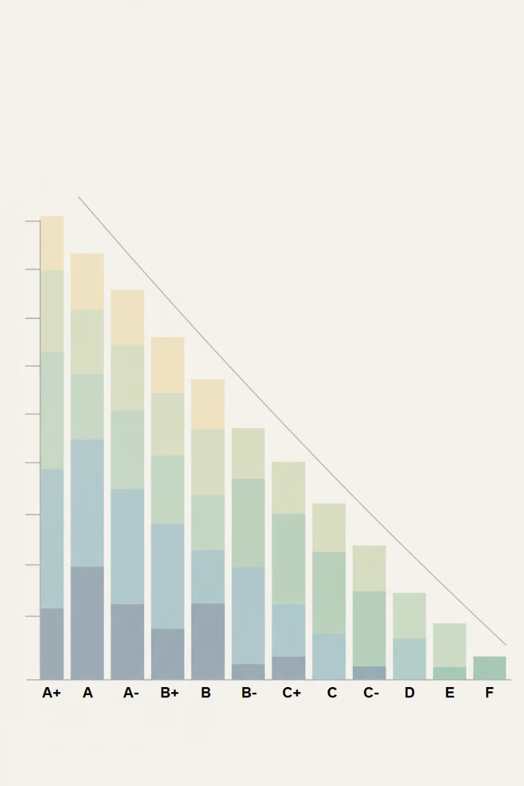




3. Ordinal Attributes
Definition:
Attributes whose values possess a meaningful order or ranking between categories, allowing for comparative relationships.
Important Characteristic:
While we can determine if one value is greater than another, the magnitude of differences between values cannot be precisely quantified.
Example 1:
Academic Grades: A+ (excellent) > A (very good) > B+ (good) > B (satisfactory) > C (acceptable)
Example 2:
Academic Ranks: Assistant Professor → Associate Professor → Full Professor

Slide 12
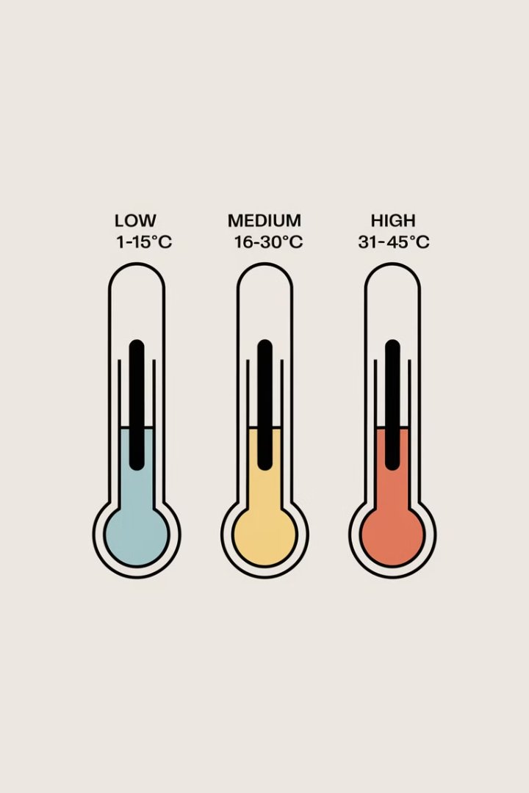
Discretization & Ordinal Attributes
Discretization:
Converting a numeric attribute into an ordinal attribute.
Example: Temperature Ranges
Low (1–15°C) → Medium (16–30°C) → High (31–45°C)

Slide 13
Ordinal Attributes - Operations
Calculating the Mode
Determining the Median
Arithmetic Operations Invalid
Most frequently occurring value (valid for ordinal data)
Middle value when ordered (valid for ordinal data)
Addition, subtraction, multiplication, and division produce meaningless results with ordinal values

Slide 14
4. Numeric Attributes
Definition:
Two types:
Quantitative attributes that are measurable.
Interval Scale Attributes
Ratio Scale Attributes

Slide 15
Discrete vs. Continuous Attributes
Discrete Attributes
Continuous Attributes
Definition:
Definition:
Attributes with a finite or countably infinite set of distinct, separate values.
Attributes that can take on any real value within a specific range.
Examples:
Examples:
Temperature readings (23.5°C, 23.51°C, 23.52°C...)
Number of customers in a store (5, 6, 7...)
Height measurements (175.42 cm, 175.425 cm...)
Number of website visits per day (342, 343...)
Time duration of a process
Count of products in inventory
Representation:
Representation:
Usually represented using real numbers (floating-point values) that can be measured to arbitrary precision.
Typically represented as integers or whole numbers, with clear gaps between possible values.

Slide 16
Comparison
Type
Key Characteristics
Example
Nominal
No order, categories only
Hair color (Black, Brown)
Binary
Two possible values
Smoker (Yes/No)
Ordinal
Ordered, but no meaningful difference
Grades (A, B, C)
Interval
No absolute zero, meaningful differences
Temperature (°C)

Slide 17

Why is Understanding Data Important?
1
Helps in data preprocessing & analysis
2
Determines the right mathematical operations
3
Essential for statistical and machine learning models

Slide 18

Data Preprocessing and Model Performance
Understanding how preprocessing transforms raw data into a usable format for machine learning:
1
Better Model Performance
2
Data Scaling & Normalization
3
Feature Encoding
4
Understanding Raw Data
Proper preprocessing ensures improved results
Crucial techniques for numeric data
Essential for nominal and binary data
Essential foundation for efficient preprocessing
The preprocessing journey transforms messy raw data into clean, structured inputs that maximize machine learning effectiveness.

Slide 19
Practical Example: Python Dataset
Example dataset: Sample Dataset with 1000 records.
Commands: import pandas as pd, df = pd.read_csv('sample_dataset.csv').
The dataset contains attributes like ID, Name, Age, Gender, Salary, etc.
Practice using real datasets to get hands-on experience.
Use Python tools like Pandas for data manipulation and analysis.

Slide 20

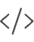


Working with Datasets in Google Colab
Google Colab is accessible through a Google account.
Google Colab: Cloud-based tool for running Python code without local setup.
Import libraries like Pandas: import pandas as pd.
Open datasets with pd.read_csv('file.csv').
Use Google Drive to store and access datasets.

Slide 21



Importing Data in Python
Understanding data types helps in preprocessing for machine learning.
View Data
Use df.head() to view the first few rows of the dataset.
Check Types
Use df.dtypes to check the data types of each attribute.
Dataset Size
The df.shape command shows the number of rows and columns in the dataset.

Slide 22
Exploring the Dataset
The DataFrame stores the entire dataset; Series stores individual columns.
Apply basic commands like df['column_name'] for column-specific analysis.
Dataframe vs Series: DataFrame is 2D, Series is 1D.
Command
Purpose
Output Type
df.head()
Explore initial rows
DataFrame
df.shape
Check dimensions
Tuple
df['column_name']
Column analysis
Series

Slide 23
Conclusion and Next Steps
1
Next Session
2
Learning Goals
3
Tools
4
Practice
In the next session, we will dive deeper into working with datasets.
Learn how to preprocess and clean data effectively.
Use Python tools like Pandas to manipulate datasets for modeling.
Start practicing with real-world datasets.
Looking forward to our next session!
May Allah bless your learning journey.

